Slide 1

GO-TO-MARKET
Strategy for launching current & new comercial printing products into the market

Slide 2
CONTENT
01
02
03
04
MARKET INTELLIGENCE
PRODUCT STRATEGY
PRODUCT DEVELOPMENT
LIFECYCLE MANAGEMENT

Slide 3

PART ONE
Market Intelligence - Customer, Market & Competition

Slide 4


NGUYEN HONG MINH
QUOTES
DESCRIPTION
“Every time I need some printings, a nearby shop would forever be a good choice.”
An 22-years old university student living in Ho Chi Minh City. Getting to a photocopy shop when having assignments or tests.
GOALS
DAY-IN-A-LIFE
Hard copies of online documents need to be prepared when being asked by the teachers and required by school projects.
Gaming is life. Using Facebook, Instagram and Youtube for entertaining and updating news.
ENGAGEMENT TRIGGERS
PAINPOINTS
Fast service is the best. And cheap price would be a plus.
Getting troubles when the photocopy shops do not provide internet access or online files transitions, but requiring USB.

Slide 5

CAO VAN DAT
QUOTES
DESCRIPTION
“Hard copies is my friend.”
35 years-old architect graduated from University of Architecture in Ho Chi Minh city.
GOALS
DAY-IN-A-LIFE
The design drawings of all projects need to be submitted to either house owner or governmen agencies for approval.
Night life is very common. Contacting every person in charge for getting the project done. Using Facebook, Instagram, TikTok, Youtube for entertaining. Going the the GYM is always in the list.
ENGAGEMENT TRIGGERS
PAINPOINTS
Fast service & friendly staff.
It would be hard to encounter any service providers who are not professional in printing techincal documents.

Slide 6

NGUYEN PHUC TUONG AN
QUOTES
DESCRIPTION
“I trust professional and up-to-date services. I need the operation to be well managed and flexible.”
28-years-old work-from-home office worker living in Ho Chi Minh City.
GOALS
DAY-IN-A-LIFE
Using hard copies when applying documents to government agencies, university campus, and self-study purposes.
Spending most of the time on computer and mobile phones. Skills upgrading and new knowdlege absorbing through self-study from various source, from online courses to printings. Using Facebook, Instagram, LinkedIn, Google Mail, Youtube for entertaining and news updating. Frequently using search engines (Explorer) and Copilot AI to learn new things.
ENGAGEMENT TRIGGERS
PAINPOINTS
Cashless payment would be great.
Never coming back if the attitude of service provider is not good. Additionally, the books when printed need to be well binded for use.

Slide 7
 | Indoor & outdoor poin-of-sale materials | Non-categorized products
Segment description | Offering printings for commercial purposes | Offering one-off jobbing work
Customer characteristics | Organizations having interest in decorating their joint space or events. | Individulas or brands who works closely with printing products
Needs, motivations, issues to solve | Using printing products for advertisement | Needing particular prints on various materials
How are they meeting their needs today? | Internet search | Visiting the nearby shops in person
Location/ geography | Ho Chi Minh City | Ho Chi Minh City
Customer example | Cao Van Dat, 35, Ho Chi Minh City | Nguyen Hong Minh, 22, Ho CHi Minh City
Key trends | Difficulty in finding professional shops | Using only mobile phones (no cash/USB)

Slide 8
MARKET SIZE
Commercial Printing | Our Segment1 | Our Segment2
Market Size (million USD) | 1412 | 656
Annual Growth (%) | 12 | 21
(not real data)

Slide 9
COMPETITORS’ REVENUE, MARKET SHARE &TRENDS
Revenue (million USD) | Competitor1 | Competitor2 | Competitor3 | Competitor4 | Competitor5
Last Year | 200 | 350 | 247 | 455 | 270
This Year | 260 | 375 | 350 | 430 | 356
Next Year | 320 | 400 | 453 | 450 | 430
(not real data)

Slide 10
COMPETITORS’ MARKET APPROACH & STRATEGY
 | HAI MINH PHAT | SONG PHAT | ARROWPRINT
Target market | Ho Chi Minh City, Vietnam | Ho Chi Minh City, Vietnam | Ho Chi Minh City, Vietnam
Strengths & core competencies | Special creative design according to customer requirements. Providing printing solutions for customers and businesses in various fields: education, government services, etc. Delivering product within 1 day at low price. | 3D printing in decal, canvas, PP, silk, wallpaper, Hiflex, blacklist flim. Large format printings, modern printing technology, ability to deliver printing products and advertisement setup for customers not only in Ho Chi Minh city but nearby provinces. | Outdoor & indoor point-of-sale materials or signage. Able to print on various kind of products or materials.
Weaknesses & gaps | Bad customer service, employees were not supportive and being rude to customers. | Customers don't know how to order, they need to visit and purchase at the store; There are no quotation for reference | The brand would be more relevant to English speakers and business while the online brand identity is not too popular.
Go-to-market approach | SEO-Publishing articles on websites; Social media marketing-Utilizing "reels" (short-video stories) on Facebook showcasing the process of making products, and posting product images on the platform; Uploading product videos on YouTube; Direct support via Zalo | Advertising product videos on third-party's YouTube; SEO-Publishing articles on website and sharing on social media; SEM-Utilizing Google Ads for appearing in top search; Posting product images on Facebook; Publishing product information on Tumblr; Direct support via Zalo. | Social media advertising (Facebook, Youtube, Pinterest, Twitter & Instagram); Direct support via Zalo, Whatsapp & email.
Pricing | Canvas printing from 110,000 VND/meter | (The business does not public their quotes on mainpage/ Contacting for more details) | (Prices vary by products & services, customers need to contact for more details)
Strategic direction | Main printing services: Digital printing, advertising printing and other print/photo/scan services. | Printing and placing event booth advertisement and other digital printings. | Full services for getting customer project done, from designing. printing to installing/delivering.

Slide 11
COMPETITIVE POSITIONING
High
Quality Services
Song Phat
ArrowPrint
Hai Minh Phat
Low
Low
Printing Product Quality
High

Slide 12
PRODUCT COMPARISON
​ | Area​ | Hai Minh Phat | Song Phat | ARROWPRINT
Features​ | Delivery | Door-to-door delivery service; Free shipping within 2km for order from 1M VND; Being able deliver products to other provinces | Door-to-door delivery service; Delivering product within 1 day. | Door-to-door delivering and guarantee services
 | Price | No factorage included | No additional fee | No additional fee
 | Services & technology | Advertising design; Printing on paper, decal, PP, canvas, fomex, standee, backdrop, band roll, backlit film, carton; Print, photo and scan files. Printing methods: Digital printing, Offset | Advertisement design; Signage installation; Event management; Printing on canvas, silk, standee, backlit film, PP, decal, poster, backdrop, wallpaper, Hiflex. Printing method: Digital printing, UV printing, large format printing | All indoor and outdoor point-of-sale materials or signage. Custom printings on various products or materials
 | Quality & capacity | Custom creative design based on customer's requirements; Customer can order 1 product at a minimum; Customer can track their products online by inputting given codes | Customize products based on customer's requirements | Capable of delivery large amount of printings for small & medium sized business. Customer support 24/24.

Slide 13
DISRUPTIVE TECHNOLOGY
Due to the shift in demand, the surplus capacity has forced vendors with larger printers to use more efficient technology to achieve economies of scale and obtain access to capital markets.
The development of technology, including quicker presses or new colors along with toner technologies, makes it feasible to produce goods of greater quality and with better manufacturing capacities.
With a rise in the digital delivery of information, commercial printers have been observed to be imbibing digital technologies to enhance packaging print quality. Quick response (QR) codes have become a basic/mainstreamed print on product packaging to be scanned with a smartphone for additional display of data, such as product info and promotional content.
Businesses use commercial printers more frequently because they are more cost-efficient and efficient for printing large quantities.
Retail, storage, and logistics companies are investing in hybrid print technologies. Hybrid technology makes combining the benefits of both digital and analog technologies feasible. To do this, the dependability and efficiency of flexographic printing are merged with the artistic possibilities of digital technology.
Commercial printing is dominated by sheetfed offset litho and digital, with inkjet growing beyond the key mailing & display areas into broader areas of commercial print.
Commercial inkjet products are gaining traction as they use less power, produce less carbon dioxide, and are associated with cleaner air as they do not emit toner dust. Many companies are investing in inkjet printers to enhance their offerings, personalize packaging and messaging, aid clients in promoting their brands, and meet the seasonality of their demand. For instance, in 2021, DS Smith Iberia installed the EFI Nozomi C18000 Plus six-color single pass-LED inkjet printer in its facility in Lisbon, Portugal. The productivity of the Nozomi is expected to reduce the time to market and offer a printing quality equivalent to that of offset printing without the need for Litho Lamination.
Improvements in productivity, speed and quality are set to open up new areas for inkjet, not only in commercial printing areas including promotional and informational print, but also in areas like packaging, decor, and textiles and promotional objects

Slide 14
DISRUPTIVE TECHNOLOGY
Although digital is expected to make further inroads during the coming years, there are a number of trends that have contributed towards improvements in business efficiencies and profitability in the sheetfed offset litho arena incorporating increasing automation (push-to-stop) and standardization, as well as growing use of UV to speed turnround.
Productivity has been boosted through the implementation of lean processes, with rising adoption of web-to-print leading to the ganging-together of standard jobs to share make-readies and lower cost.
In electrophotography, much of the focus today has been in improvements in print quality and also moves towards larger format print, with step changes in productivity and cost being seen in the current year.
In inkjet, meanwhile, print quality improvement is also a few focus, including on standard papers, wide format, webfed (new finishing solutions) and sheetfed presses.
Digital finishing and embellishment is also growing across the board.
There is much interest in key Landa installations, with its sheetfed and web nanographic printing presses said to offer the versatility of digital printing with the qualities and speed associated with offset, employing water-based inks and a novel image transfer system.
The ink image is converted into a very thin polymeric film on a hot blanket, which is then transferred onto the cool paper surface. This is claimed to avoid any issues of paper saturation that can be associated with conventional inkjet processes, and to provide high-quality images at high print speeds.
In Europe, Landa machines are being used or about to be installed in four plants in Germany, the UK, France and the Netherlands, as well as at several packaging providers.
Early adopters report the Landa technology is highly competitive in the range of 250-500 sheets against litho and other digital processes

Slide 15
PART TWO
Product Strategy - Vision, Objectives & Strategy

Slide 16
CORPORATE VISION & OBJECTIVES
PRODUCT VISION
PRODUCT OBJECTIVES
To sustainably grow the entire business with respect to conducting full responsibilities to Vietnam rules and regulations, business ethics and valuing every customer experience.
To ensure that every print is of the highes quality, with vibrant colors, sharp images and crisp text.
Achiving good NPS score in the industry
Annual revenue > USD $100,000, with approximately $30,000 of profit.

Slide 17
PRODUCT STRATEGY
 | Markets, customers, and technology
Target market & market trends | We targget business owner looking to enhance their brand identity or an individual seeking personalized gifts. The commecial printing in Asia Pacific market is expected to grow by 1.19% (CAGR) during 2023-2028.
Market landscape | The exploding need for labels and packaging in the e-commerce sector significantly contributes to the growth of the commercial printing market. The increasing demand for processed and canned food in emerging markets such as China and India is expected to impact the market in the region positively. Also, the increasing disposable income in the region is resulting in the growing demand for interior design with customized wallpapers. The Vietnam printing market has experienced substantial growth in recent years, driven by the country`s expanding advertising and packaging industries, increasing demand for printed materials, and technological advancements in the printing sector. Printing services play a crucial role in advertising, publishing, packaging, and promotional materials.
Target customers | We primarily target foreigners living in Ho Chi Minh City of Vietnam. However, both Vietnamese locals and expats would be our targets in long-term.
PEST Analysis | ECONOMIC Digital printing technology is anticipated to experience the fastest growth. Advertising application of commercial print plays a vital role in brand promotion and customer engagement. The development of machinery, digitization, and computerization have greatly improved productivity and transformed this industry so that growth capability is no longer correlated with direct labor. The rising costs of raw materials throughout the procurement process limit the operational capacity of many enterprises. SOCIAL Businesses require increasing promotional materials. The short-run self-publishing industry witnesses a high demand for digital printing. The COVID-19 pandemic has resulted in a spike in demand for packaging for food. The booming e-commerce market across the world offers a lucrative opportunity for commercial printing providers, as e-commerce players rapidly adopt innovative printing solutions for their daily packaging. Customized marketing messages in promotional and marketing strategies is one of the drivers of the commercial printing industry. The growing popularity of the commercial printing industry is being impacted by vendor consolidation. POLITICAL The demand for printing from packaging and labels for pharmaceuticals, tobacco products, and alcoholic beverages is expected to increase. Therefore, the companies must comply with dynamic government regulations and protect against counterfeiting. TECHNOLOGY Vendors with larger printers use more efficient technology to achieve economies of scale and obtain access to capital markets. Retail, storage, and logistics companies are investing in hybrid print technologies. Commercial printing is dominated by sheetfed offset litho and digital, with inkjet growing beyond the key mailing & display areas into broader areas of commercial print. Businesses improve efficiencies and profitability in the sheetfed offset litho arena incorporating increasing automation (push-to-stop) and standardization, as well as growing use of UV to speed turnround. There is much interest in key Landa installations, with its sheetfed and web nanographic printing presses said to offer the versatility of digital printing with the qualities and speed associated with offset, employing water-based inks and a novel image transfer system.

Slide 18
PRODUCT STRATEGY
 | Competitive Differentiation & Business Models
Our competitors | We are competing with significant competitors like Hai Minh Phat and Song Phat. In 2022, our annual revenue exceeded USD$100,000, accounting for about 0.0014% market share in Vietnam.
Our competitive advantages | Our competitive adavantage comes from years of experience in the Vietnam commercial printing industry of business experts and loyal customers who jhave trusted in our brand for yeas of cooporation. This allows us to continuously bring our products closer to more customers and thier friends all around Vietnam.
Disruptive technology | Printing technology will continue to evolve, but we are able to stay ahead of – and use – latest technologies.
Our business model | Web-to-print - We make money by using appropriate workflow solutions to apdapt wtih the user expectations which are changing, and moves towards just-in-time delivery and fast turnround across the board. Orders are placed on a web site or portal, choosing from a catalogue of stock items or specifying and creating the printed material using the online app. Typically, these systems will generate artwork (or allow upload of artwork into a workflow with pre-flight); provide estimates and accept payment (as an order number for established client or through funds transfer for a new customer) as part of the process . Customers may be businesses or individual consumers. Trade print services are growing strongly – often offering a service branded as the buying organization. There is no direct sales person involvement; the system handles the transaction completely. (*) Web-to-print (Web2Print, WTP) is a broad term that covers the e-procurement mechanism of print buying.
Emerging business models | Workflow, from customer enquiry to delivery, is critical for commercial print businesses to be successful as run lengths fall while customers expect ever faster delivery. To own the relation with the buyer, commercial printers develop workflow solutions that automate artwork production and administration. Some printers have succeeded in trapping the series of processes — design, materials, suppliers, production and distribution — into an on-demand app-accessible service. A key change has been in the role of commercial printing companies at the cutting edge, many of which now has reduced direct relations with their customers but instead deal mainly or in some exclusively with resellers, and focus entirely on building the most efficient printing business, in part through the adoption of online ordering, web-to-print. This has opened the market for individual consumers and micro businesses, to create small quantities of promotional and marketing collateral at affordable costs. Companies have been finding ways of creating value for themselves, their suppliers, converters and users, by developing a new layer that integrates them all with maximum utility. ‘Uberization’ is developing in many industries, where the focus is on the customer and not the manufacturing.

Slide 19
PRODUCT STRATEGY
 | Top-level recommendations
Recommendations for major initiatives over the next couple of years | ArrowPrint will continuously enhance the customer service and guarantee policy to further increase customer engagement as well as strenghten the relationship with current and potential B2B clients. Investing in printing technology and incorporating logistics services to push our efficiency and therefore delivering more quantities within shorter amount of time. Developing on-demand app-accessible service to formulate workflow that automate artwork production and administration.
Vision and objectives vs initiatives mismatch | ArrowPrint’s high quality products and services will help us stand out from the competitors by not only providing B2B & individual customers with what they need but also the profession and passion in what we do. With that in hand we are confident to earn more trust from both the current and prospective customers.
Rejected recommendations | We considered maintaining our canvas printing as one of the primary services, but the market trends fro canvas is no longer popular and the revenue upside for this is small.
 | Our capabilities & product roadmaps
Capabilities and gaps | We have 80% of the capabilities we need to carry out those initiations. We are having gaps around product installation and delivery experience. Our marketing and sales staff will need more trainings to professionally serve customers. We also need more R&D workforce to continously test and update our product quality and service packages.
Staging, pacing, and product roadmaps | Q1: Training the current sales, marketing and customer service staff using this GTM strategy and get all the promotional materials in place. Aslo, hiring a new team of software development for building our Web-to-print application or outsoucing. Finally, developing guarantee policy for B2B purchasing customers and get our application built. Q2: Launching the first version of Web-to-print application, continually testing UI/UX and fixing bugs. Q3: Researching cusomers and continously refining our offerings Q4: Pilot our products and services to larger audience
 | Impact
Cost of recommendations | Total investment required in this year is approximately $15 thousand USD, with salaries for the new staff accounting for most of the costs.
Benefits of recommendations | ArrowPrint will generate more than $150,000 USD this year and expected to grow to more than $200,000 next year. Developing workflow solutions that automate artwork production and administration will help increase our use base by 50%, equivalent to 10,000 people and likely give us 0.0025% share. (not real data)

Slide 20
PART THREE
Product Development - Prioritization, Stage-Gate & Launch

Slide 21
Products | Sales channels
 | Technology
 | Services
1H 2022 | 2H 2022 | 2023
Website UI/UX optimizing
Application developing
App soft launch
App UI/UX testing & bugs fixing
Rewarding points accumulating system
AI design tool incorporating
Printing technology adopting
Guarantee policy enhancement
Incorporating logitics services

Slide 22
OKRs for Q2-2026 |  | Score
Objective 1: Promoting our serevices to larger audience
Key results | Key result #1 Achieving approximately 100,000 visits on website
 | Key result #2 Achieving around 5,000 new followers on social media
 | Key result #3 Generating 9,000 leads on website and 900 leads on social media (CVR~9%)
Objective 2: Leads generation
Key results | Key result #1 Attracting 1,000+ in-store purchasing customers
 | Key result #2 Receiving aroound 900 orders via social media and website
 | Key result #3 Generating approximately $37,000 in revenue
Objective 3: Customer satisfaction
Key results | Key result #1 Receiving above 25% retention rate monthly
 | Key result #2 NPS >40%
 | Key result #3 Achieving from 4.0/5 star review on Google Business profile

Slide 23
PRIORITY I
Major strategic launch
PRIORITY II
Web-to-print application
Supporting launch
PRIORITY III
Incorporating AI design tool and rewarding points accumualting system
Maintenance launch
Bug fixes, quality improvements and loyalty customers appreciation programs/promotions.

Slide 24
LAUNCH DELIVERABLES
 | Items | Priority III | Priority II | Priority I
Planning | Launch plan |  |  | x
 | Budget Management |  |  | x
Marketing | Basic marcom |  | x | x
 | Advanced marcom |  |  | x
 | Press release |  |  | x
 | Marketing programs & promotions |  |  | x
Sales & Account Management | Communications to internal sales | x | x | x
 | Communcation to sales channels |  | x | x
 | Communication to clients |  | x | x
 | Sales tools & presentations |  | x | x
 | Sales training |  |  | x

Slide 25
 | Launch plan - outline
1 | Market environment | Target - Organizations and individual customers having interest in promotional materials and personalized printing products. Market trends - Customers seeking improvements in printing productivity, speed and quality. User expectations are changing, and moves towards just-in-time delivery and fast turnround across the board. Competitions - Printers are seeking to serve the increasingly demanding customer more quickly, more sustainably, more cheaply, more relevantly and with less or no stock to burden them.
2 | Product | Value propositions (see part four) Service description - Providing indoor and outdoor point-of-sale materials and other printed items Pricing - Competitive pricing (cost-base pricing) Competitive differentiation - Capable of delivery large amount of printings for small & medium sized business and custom printings with automating workflow from order placing to product administration.
3 | Launch planning | Timing - Q1/2026 Budget - $3,000 Goals & metrics (see OKRs and customer journey)
4 | Messaging | Customized marketing messages in promotional and marketing strategies is one of the drivers of the commercial printing industry.
5 | Awareness, Interest, preference | Guiding customers throough customer journey with targeted content. Launching social media advertisements, Google Search advertisement, marcom.
6 | Sales & channels | Trainng of sales reps and customer support. Launching sales promotions.
7 | Technical support | Training and preparation.

Slide 26
PART FOUR
Lifecycle Management - Positioning, Marketing & Sales

Slide 27

VALUE PROPOSITION
At Arrowprint, we understand the importance of making a lasting impression. Whether you are a business owner looking to enhance your brand identity or an individual seeking personalized gifts, our dedicated team is here to bring your vision to life. Our expert printers and designers work tirelessly to ensure that every print is of the highest quality, with vibrant colors, sharp images, and crisp text. We pride ourselves on delivering exceptional results that exceed your expectations.

Slide 28
AWARENESS
CONSIDERATION
PREFERENCE
ACTION
LOYALTY
Define Needs | Evaluate Needs | Response Decision | Category Decision | Brand Decision | Purchase | Setup/Unbox | Initial Usage | Extended Usage
Pain Points
Prospective customers are not aware of ArrowPrint
Prospective customers do not know a WTP app exists
Prospective customers are aware of their needs for efficient printing production
Prospective customers are requiring better customer services
Customers narrow down printing business in the living area
Customers ask for recommendations from acquaintants
Customers researching nearby printing with good rating point from google reviews
Fast delivering
Supporting staff
Professional services
Online payment
Nearby
Abling to track down the delivering process
Incorporating installation and delivering services
High quality of printing
On-time delivery
Maintenance services for signages
Reporting issues channel/hotline
Saving points after purchasing for more upcoming promotions
Touch points
Search engines
Ads
WOM recommendations
Product website
Search engines
Social networks
Customer reviews
Friends recommendations
Google business
Product website
Social media
WTP application
Chat support (Zalo, Whatsapp)
Social media
WTP application
Chat support (Zalo, Whatsapp)
Annual sales
Average sales amount
Number of units sold
Average lifespan
Churn rate
Advertising recall
Page followers
Product market share
Which services are being used the most
Market trends
Feature affinity
Which features are driving sales & WOM
CTR
%Visitors clicking CTA buttons
Shopping cart abandonment rate
%Visitors having items in cart but never order
Average time onsite
Engagement measurement
App downloads
Number of downloads on app store
Daily active users
Net Promoter Score (NPS)
Likelihood to recommend
Retention rate
Likelihood for repurchasing
Metrics
Brand leaders & laggards
Brand mentions VS other brands
Social media
Number of mentions: Positive & negative
Ownership
Opportunities
Marketing
Marketing & BI
IT & BI
Marketing
Optimize product website and application
Show how people reacting to company product
Optimize user engagement
Releasing articles, videos and other content

Slide 29
PRODUCT DISCOUNT
(from financial report)
List (preference) price | $500
Unit sold | 10,000
Revenue | 4,250,000
Average revenue per unit | $425
Discount per unit | $75
Discount percent | 15%
Discount “dollar” | $750,000
List (preference) price | $500
1-500 units | Up to 5% discount
500-1000 units | Up to 10% discount
1000+ units | Up to 15% discount
(*) Opportunities for reduction of discount: 1-in-store purchasing 2-Expecting the products to be delivered sooner than estimated delivery date
(not real data)

Slide 30
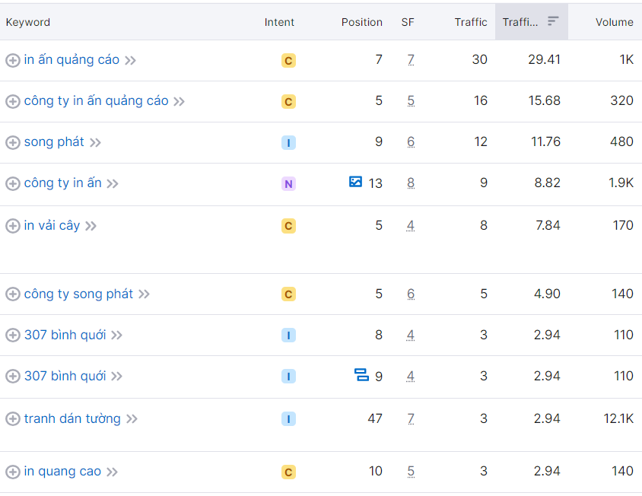
MARKETING RECOMMENDATIONS
Search Engine Optimization - Targeting informational keywords

Slide 31
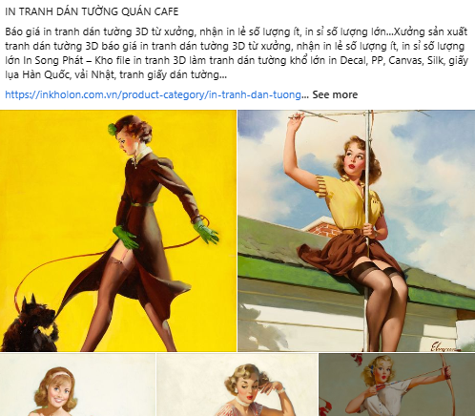
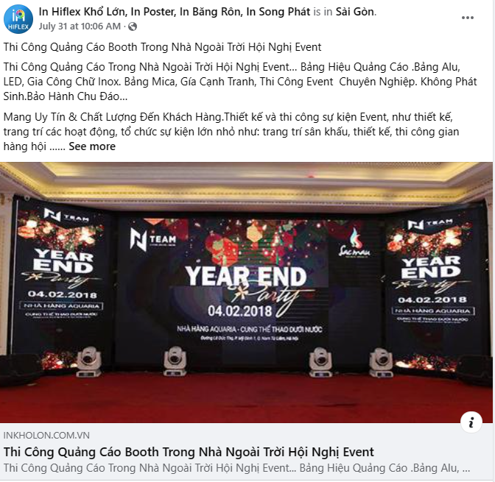
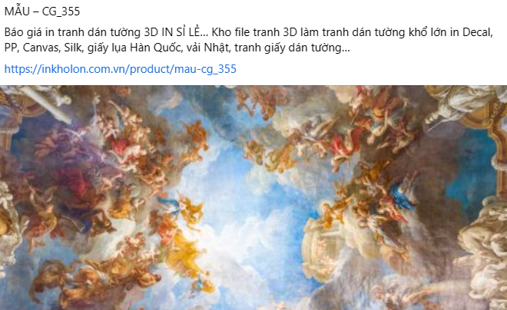
MARKETING RECOMMENDATIONS
Social medial marketing (Facebook)
Blogs/youtube's links sharing, product images, informative description and contact details can be included in a Facebook's post.
(*) make sure your content is readable, for example: using bullet points for listing service offerings.

Slide 32
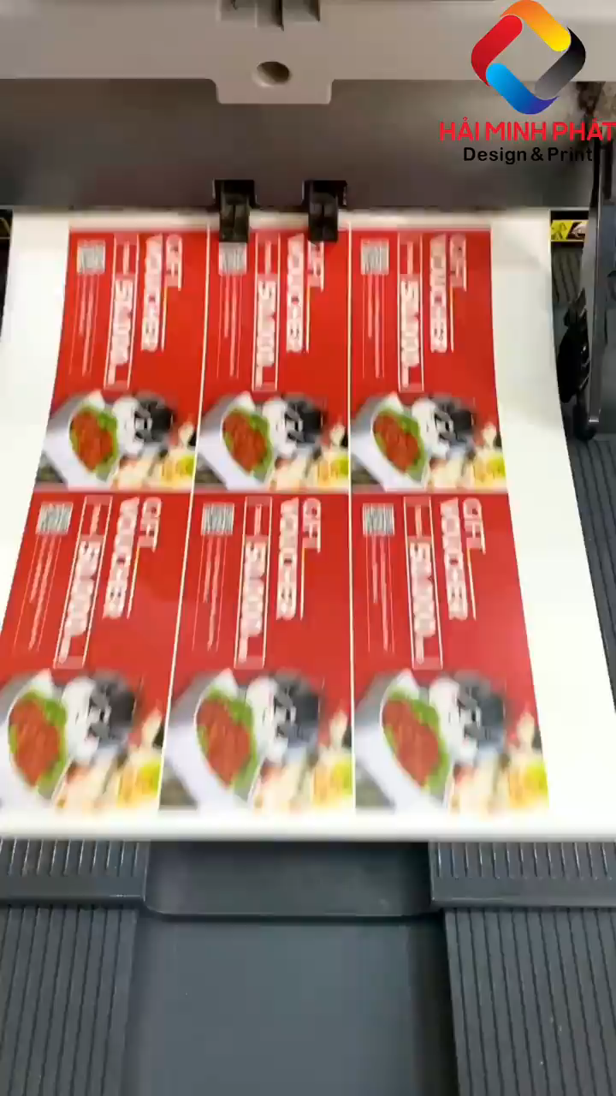
MARKETING RECOMMENDATIONS
Social medial marketing (Facebook)
Utilize Facebook Reels for user engagement;
Show more content about how your products are made, where they are made and how they look like when finished.
Click to play video

Slide 33
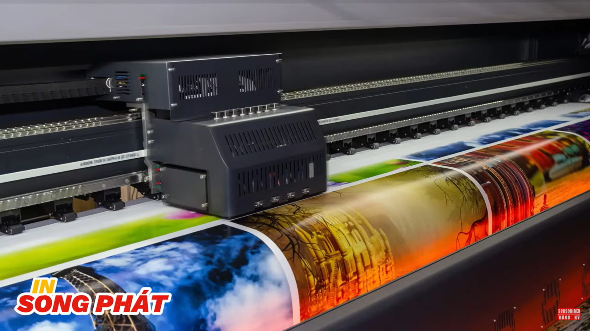
MARKETING RECOMMENDATIONS
Social medial marketing (YouTube)
Partnering with marketing agencies for PR articles and brand advertising on YouTube.
Case study: Heytv.vn has been filming, editing and advertising videos of commercial printing businesses on YouTube. SONG PHAT's videos on HeyTV's channel have reached over 100K views.
In UV Khổ Lớn Chất Lượng Vượt Trội Cho Những Bản In Ấn Đặc Biệt

Slide 34

MARKETING RECOMMENDATIONS
Zalo
Vietnamese customers prefer this channel for asking information about the service, either by chatting or calling.
Coding a Zalo button on your home page would make it more convenient for customers.

Slide 35
THANKS
May you have any questions, please kindly contact kimmyle081@gmail.com (Ms.Kimmy)

